Slide 1

AI-Based Fraud Detection System
Protecting online payments with intelligent automation
BY HK05 - Adarsh Lins , Archana M , Aliza shibu

Slide 2

THE CHALLENGE
The Growing Fraud Problem
Rising Threats
Financial Impact
Early Detection
Online payment fraud is increasing rapidly
Companies are losing significant money
We need a system to detect fraud early

Slide 3


DATA INTELLIGENCE
Key Data Points We Analyze
Transaction Amount : Checks if the amount is unusually high compared to normal spending.
Location : Identifies transactions made at unusual hours.
Device Used : Detects sudden changes in city or country.
Failed Login Attempts :Multiple failed login attempts may indicate someone trying to access the account illegally.

Slide 4
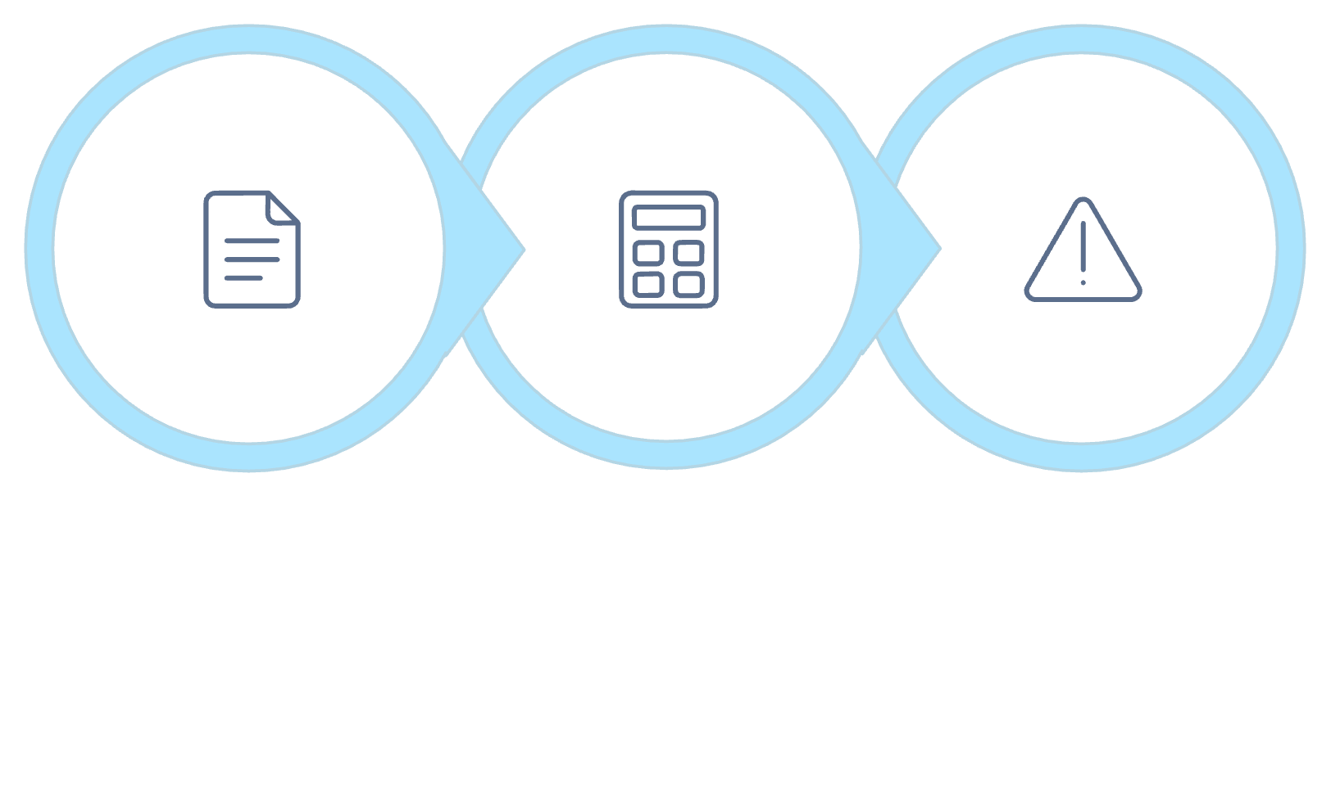
HOW IT WORKS
Our AI Detection Process
Smart Decision System
Low risk → Approve instantly
Medium risk → Send OTP verification
High risk → Block transaction + Alert
Check Details
Calculate Score
Risk = Fraud

Slide 5



KEY BENEFITS
Why Choose Our System
Reduces Fraud Loss
Protects Customers
Fast Decisions
Minimize financial impact from fraudulent transactions
Keep customer accounts and data safe
Automatic real-time fraud detection

